Slide 1
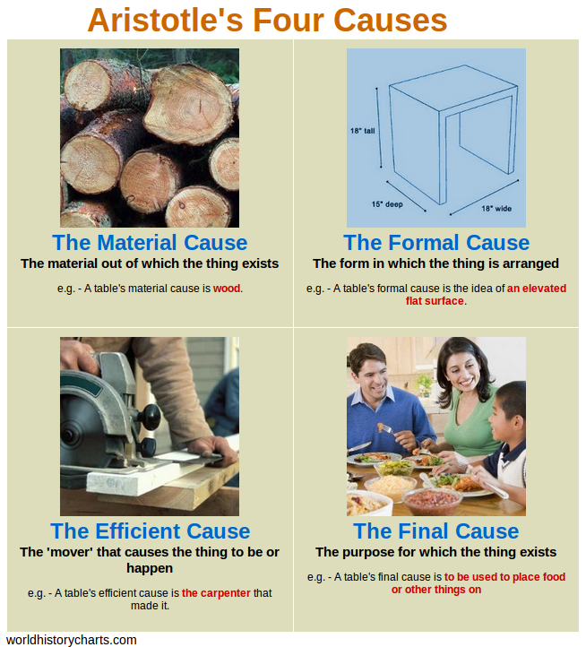
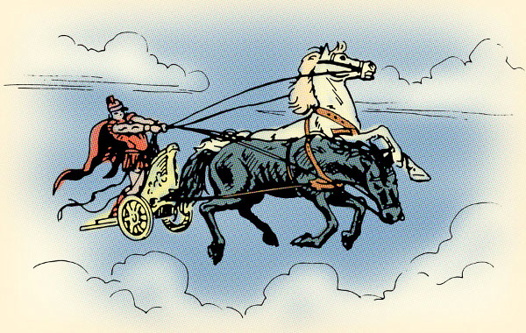
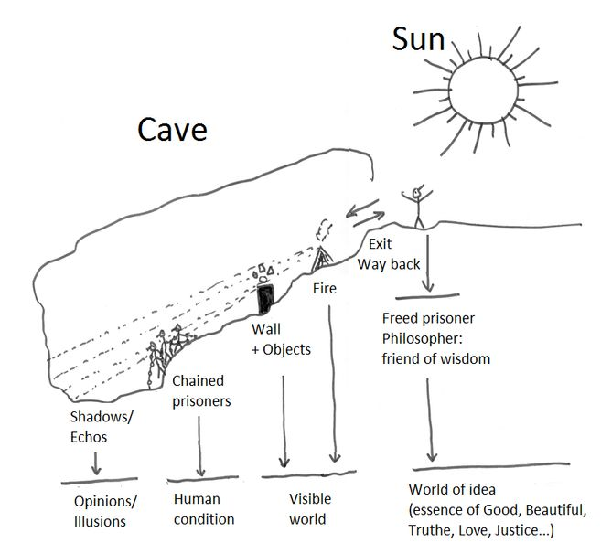
PR1: Ancient Philosophical Influences – Knowledge Organiser
Time line of philosophers and useful quotes
1. Pythagoras (570-495 BCE) | “Reason is immortal, all else mortal.” – Pythagoras influenced Plato
2. Heraclitus (535 - 475 BCE) | “No man ever steps into the same river twice” Quoted by Plato about Heraclitus
3. Socrates (470 – 399BCE) | “The unexamined life is not worth living”
4. Plato (428 – 347 BCE) | “On the walls of the cave, only the shadows are the truth.”
5. Aristotle (322 - 384CE) | “The whole is more than the sum of its parts”
18.
19.
Evaluation of Aristotle’s use of the senses and Plato’s reliance on reason.
6. Aristotle disagreed with Plato, he was more of a a materialist and stipulated there was no empirical evidence or proof that forms exist beyond this world. | 9. Plato disagreed with Aristotle. He postulated that we can rely on a prioi reasoning, Plato was a dualist, an absolutist and our goal was to be a ‘philosopher king’.
7. Aristotle deduced objects change in different ways and these changes are caused. If there is change, this has to be initiate by a Being, this Aristotle called the Prime Mover, who was an intelligent and transcendent. | 10. Plato’s chariot shows that our souls are like horsemen and that we need reason to control the appetite, driving towards The Good (Beauty, Truth and Justice).
8. Plato said “The good, then, is the end of all endeavour, the object on which every heart is set.”, but few philosophers accept his theory of forms today, e.g., is there an ideal form of cancer? | 11. Descartes also supported Plato’s reasoning against Aristotle relying on rationalism. ‘cogito ergo sum’ demonstrates the only knowledge we can rely on is our minds and not trusting in our senses.
20.
21.
22.
Spirit
Plato’s Chariot
Evaluation points on Plato’s form of the Good and Aristotle's Prime Mover
12. A.Y.Ayer (19th Century) claims that Plato has ‘primitive superstition’ referring to the noun of ‘Good’. So when we talk of something good we are simply expressing our own emotional reaction, not a referring to any real knowledge. | 15. Philosophy criticism: A fallacy of composition cited by David Hume (18th Cent.) suggests that because something is true of the parts, does not mean that the same must be true of the whole, e.g., Just because all humans have mothers, its does not follow that humankind has a mother.
13. Karl Popper (20th Century) maintains that Plato is determined to find a certainty in the Form of the Good that cannot be found in this world of continual change. | 16. Philosophy criticism: Aristotle argues there is purpose or telos to everything. Evolution suggests there is a randomness and destruction of species. Bertrand Russell (20th Cent.) said ‘the universe is just here, and that’s all’.
14. Richard Dawkins (21st Century) reasons that it is nonsense to talk of a transcendent other world beyond the physical. He would argue against Plato there is no metaphysical world of the forms/ideas of the Good. | 17. Scientific criticism: In Big bang theory, Edwin Hubble (20th Cent.) contradicts Aristotle's idea of a god who brings the world into motion by attracting it to himself. Instead, we are presented with a violent beginning of an ever expanding universe, which does not need a god.
Reason
23.
24.
Appetite
Plato’s Cave
29.
28.
26.
25.
30.
27.
Illusion Belief Wisdom Reality

